Slide 1

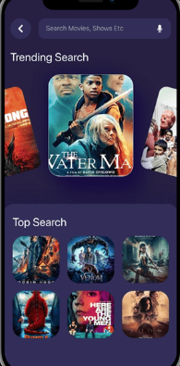
Streaming Service Database
Siddharth Kumar Ritesh Singh Kushwaha Amritanshu Kumar

Slide 2

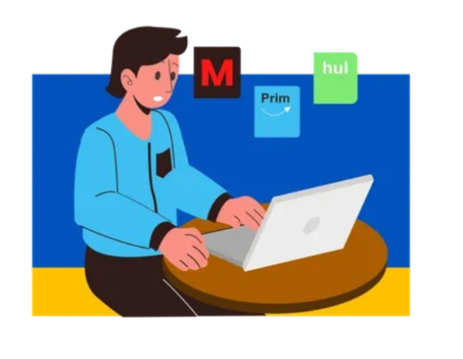
INTRODUCTION
THEN
NOW

Slide 3
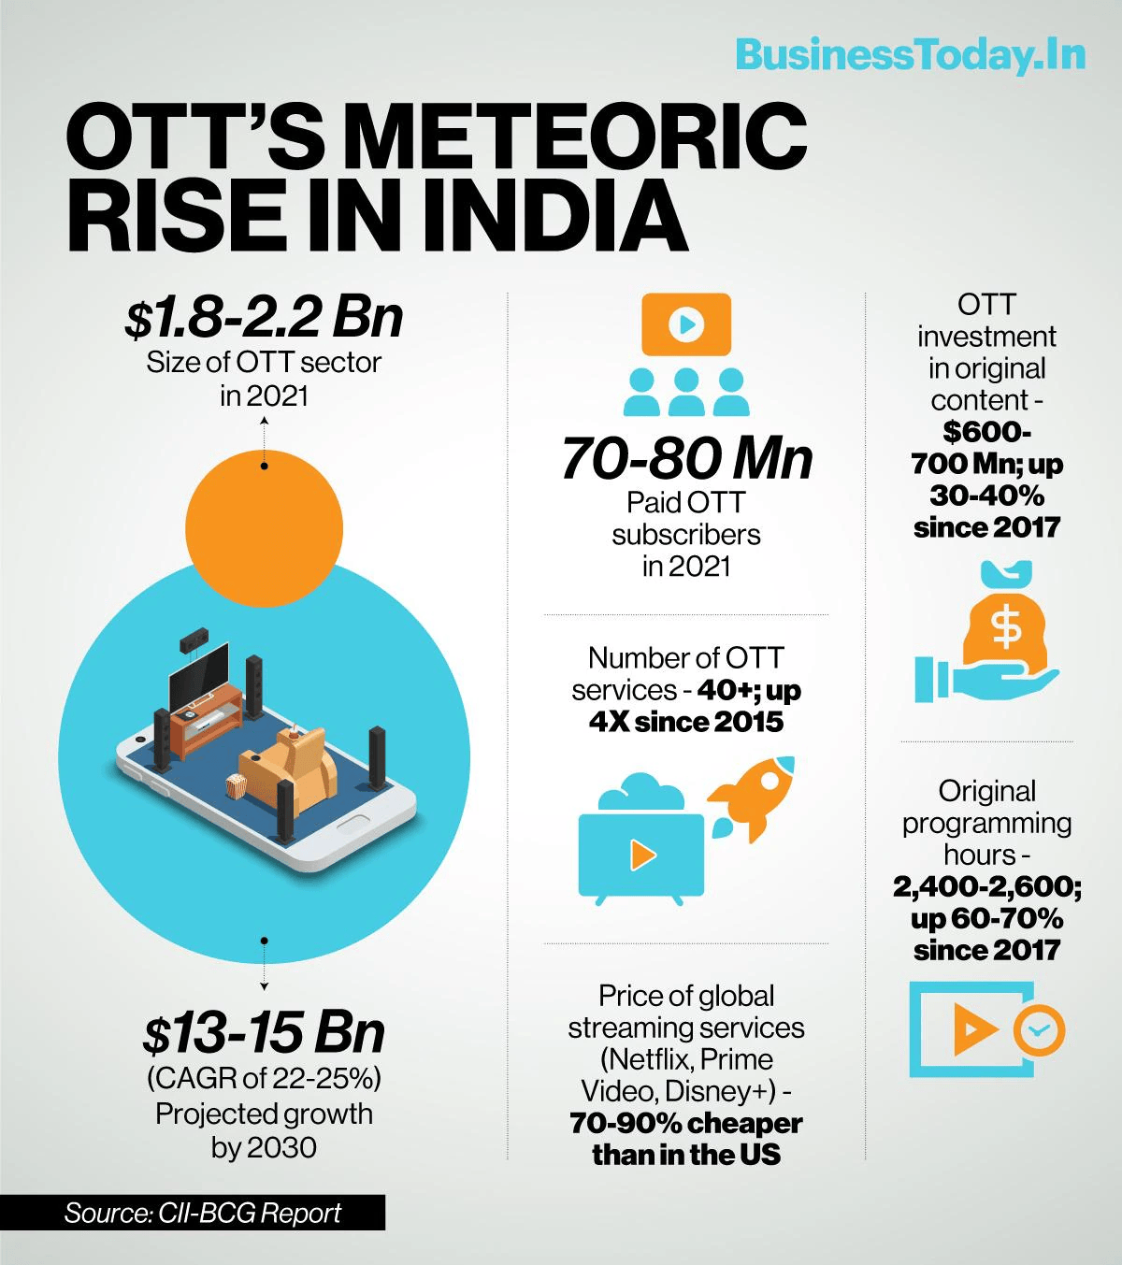
ORIGIN OF IDEA
businesstoday.in - Jan 2022

Slide 4
PROBLEM OR CHALLENGES
01
02
WRONG AUDIENCE PROFILING
USER EXPRIENCE
Difficulty in accurately understanding user preferences for personalized content recommendations.
Poor interface design and device compatibility leading to a frustrating experience for users.
03
04
VIDEO PIRACY
RETENTION
Protecting content from the unauthorized access and ensuring regional licensing compliance.
Struggling to keep users engaged and reduce churn due to competitive offerings and suboptimal user experiences.

Slide 5
OBJECTIVE
SMOOTH CONTENT CATEGORY
SCALABILITY
MULTI-USER SUPPORT
Handle multiple users and their personalized content.
Efficiently categorize content by genre, ratings, and language.
Ensure the database can scale to handle large datasets.
PERFORMANCE OPTIMIZATION
DATA SECURITY
REDUNDANCY AND CONSISTENCY
Optimize for fast query response times and high performance.
Eliminate redundancy and ensure data integrity.
Protect user data and prevent unauthorized access.

Slide 6






PROJECT SCOPE
USER MANAGEMENT
PERSONALIZED RECOMMENDATIONS
SUBSCRIPTION HANDLING
DEVICE SUPPORT
CONTENT MANAGEMENT
ANALYTICS AND INSIGHTS

Slide 7

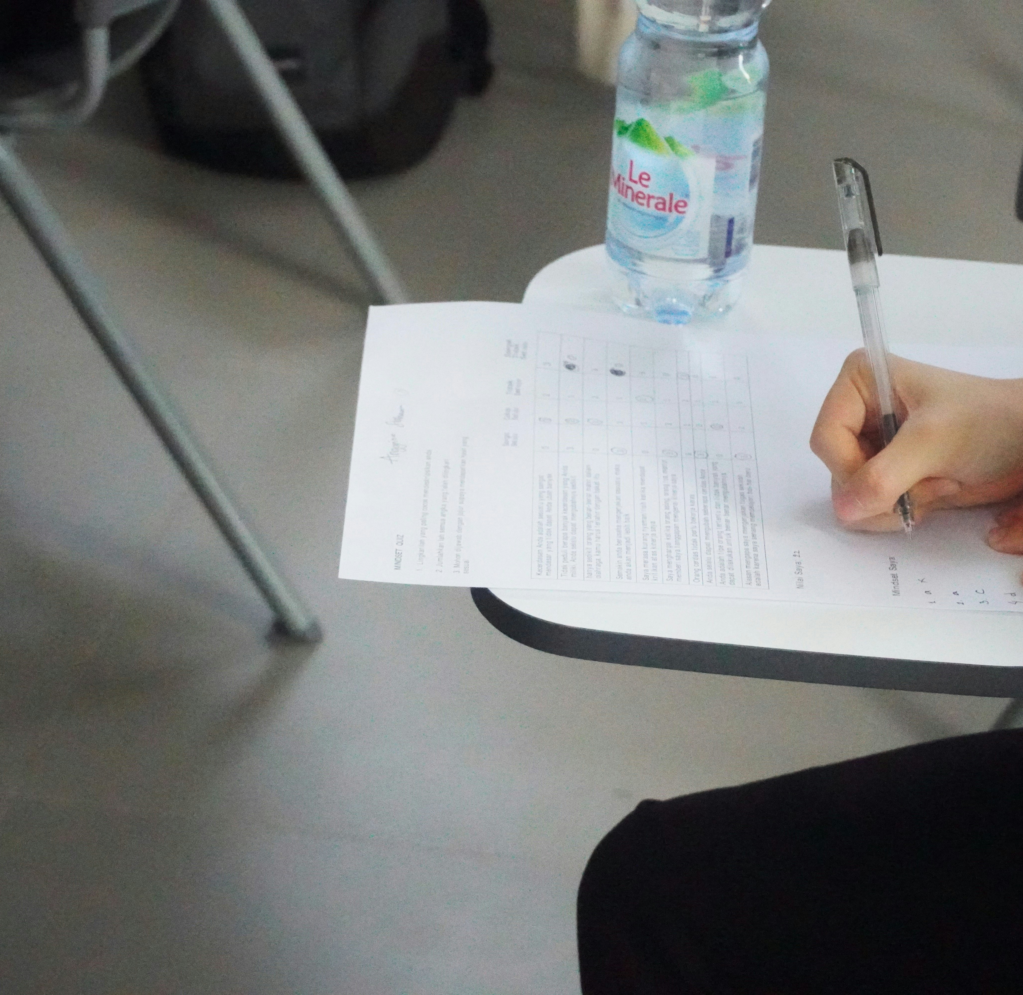
INTERVIEWS AND SURVEYS
WEB EXPLORATION
REQUIREMENT GATHERING

Slide 8
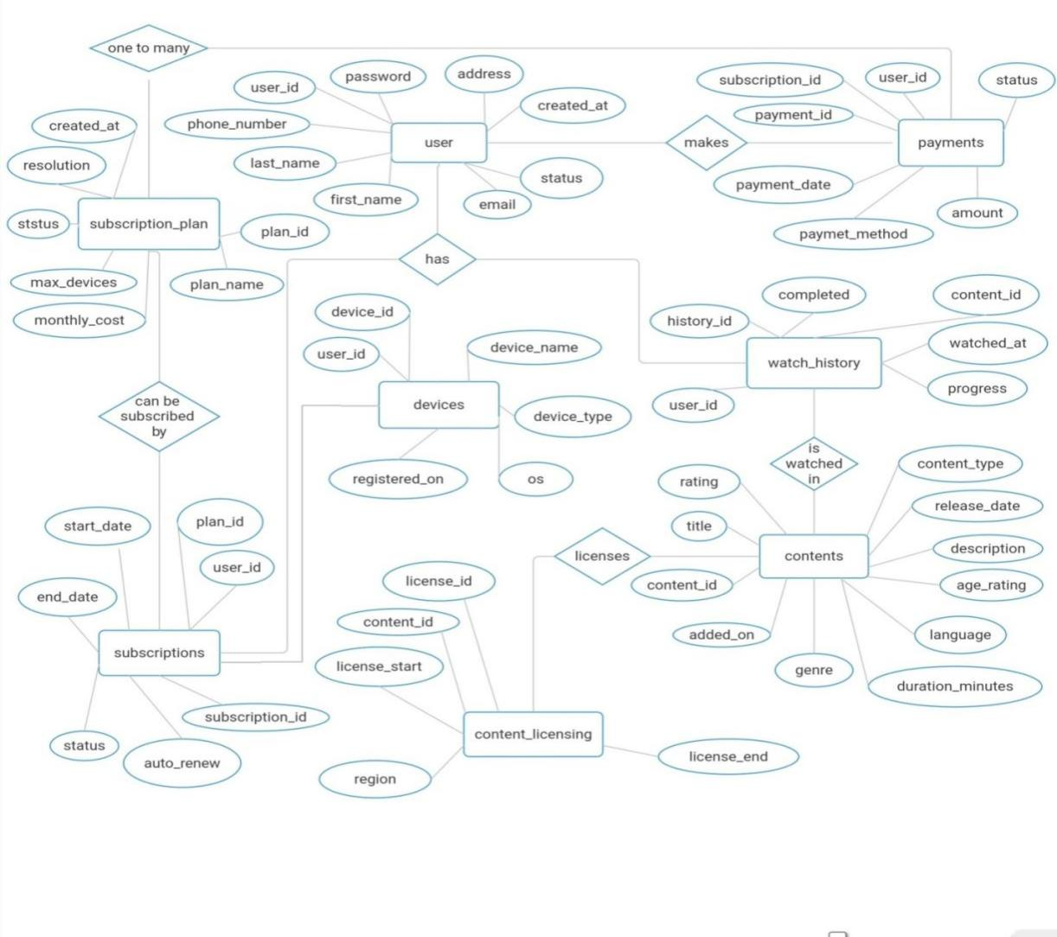
ENTITIES RELATIONSHIP

Slide 9
NORMALIZATION
25%
45%
65%
1 NF
2 NF
3 NF
Ensure that attributes must be atomic, columns must have unique names, store consistent data types, and row/column order doesn't matter.
Eliminates partial dependencies, ensuring that all non-key attributes are fully dependent on the primary key.
Removes transitive dependencies, ensuring no attribute is indirectly dependent on the primary key.

Slide 10
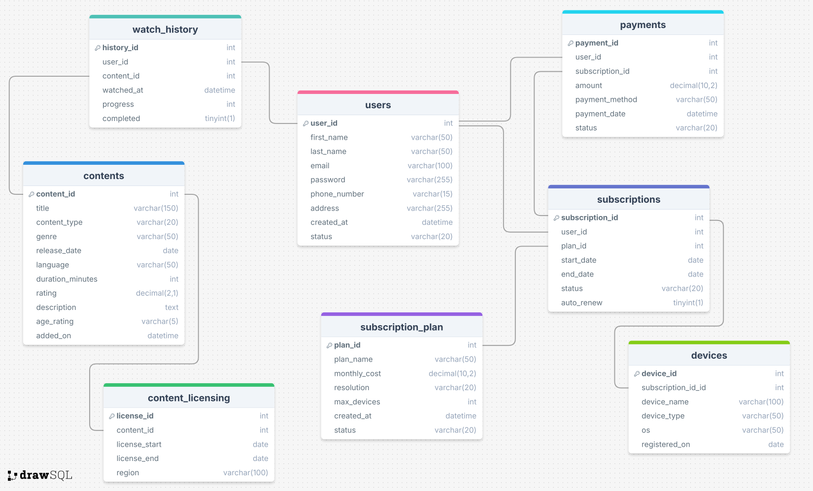
DATABASE STRUCTURE

Slide 11

SQL QUERIES
DML
DDL
DCL
TCL
SELECT
INSERT
UPDATE
DELETE
CREATE
ALTER
DROP
TRUNCATE
RENAME
GRANT
REVOKE
COMMIT
ROLEBACK
SAVE POINT

Slide 12
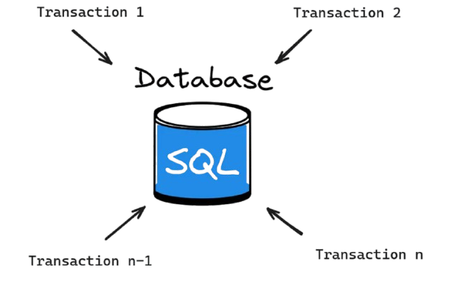
WHAT ABOUT HANDLING CONCURRENT OPERATIONS?

Slide 13
PL/SQL
T-SQL
Exclusively for Oracle databases.
Uses EXCEPTION block.
Supports FOR, LOOP, GOTO, and Packages.
Support Functions, Stored Procedures, Cursors.
Exclusively used with Microsoft SQL Server
Uses TRY...CATCH block for error handling
Supports WHILE, IF...ELSE
Also Support Functions, Stored Procedures, Cursors.

Slide 14
FUNCTIONS
Reusable database objects that accept input parameters, perform operations, and return a value. They can be scalar functions (returning a single value) or table-valued functions (returning a table).
1) Cannot modify database state (no INSERT, UPDATE, or DELETE operations),
2) Cannot manage transactions (no COMMIT or ROLLBACK),
3) No side effects (only read operations).

Slide 15
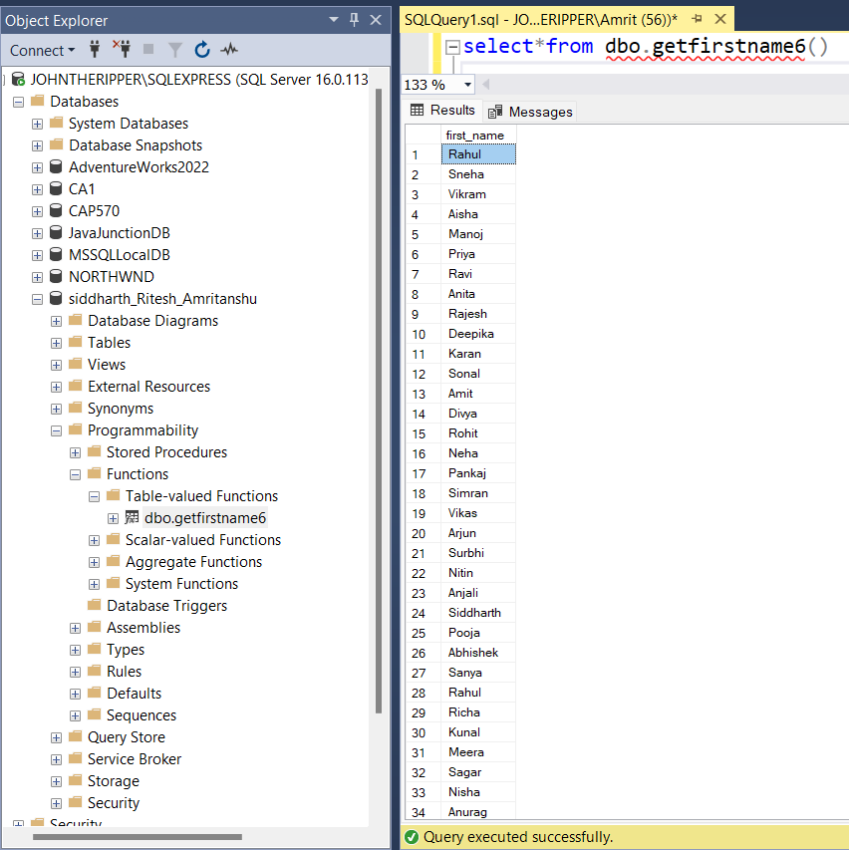
Non Parametrized Function To fetch first name of all the users
create function dbo.getfirstname6()
returns table
as
return (Select first_name from dbo.users);
select*from dbo.getfirstname6()

Slide 16
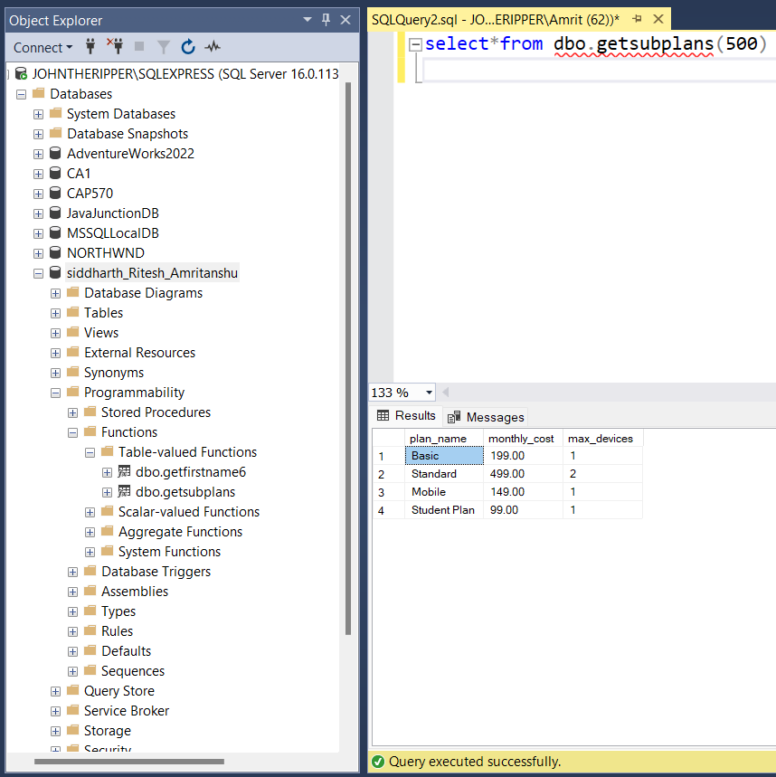
Parametrized Function to get the list of subscription plans whose monthly cost is less than or equal to the given amount
create function dbo.getsubplans(@cost int)
returns table
as
return (Select plan_name, monthly_cost, max_devices from dbo.subscription_plan
where monthly_cost = @cost or monthly_cost<@cost);
select*from dbo.getsubplans(500)

Slide 17
STORED PROCEURE
Precompiled collection of SQL statements that can be executed as a unit, allowing for encapsulation of complex business logic and reusability across different applications or queries).
Stored procedures can perform actions like data modification (INSERT, UPDATE, DELETE) and handle transactions using BEGIN TRANSACTION, COMMIT, and ROLLBACK.

Slide 18
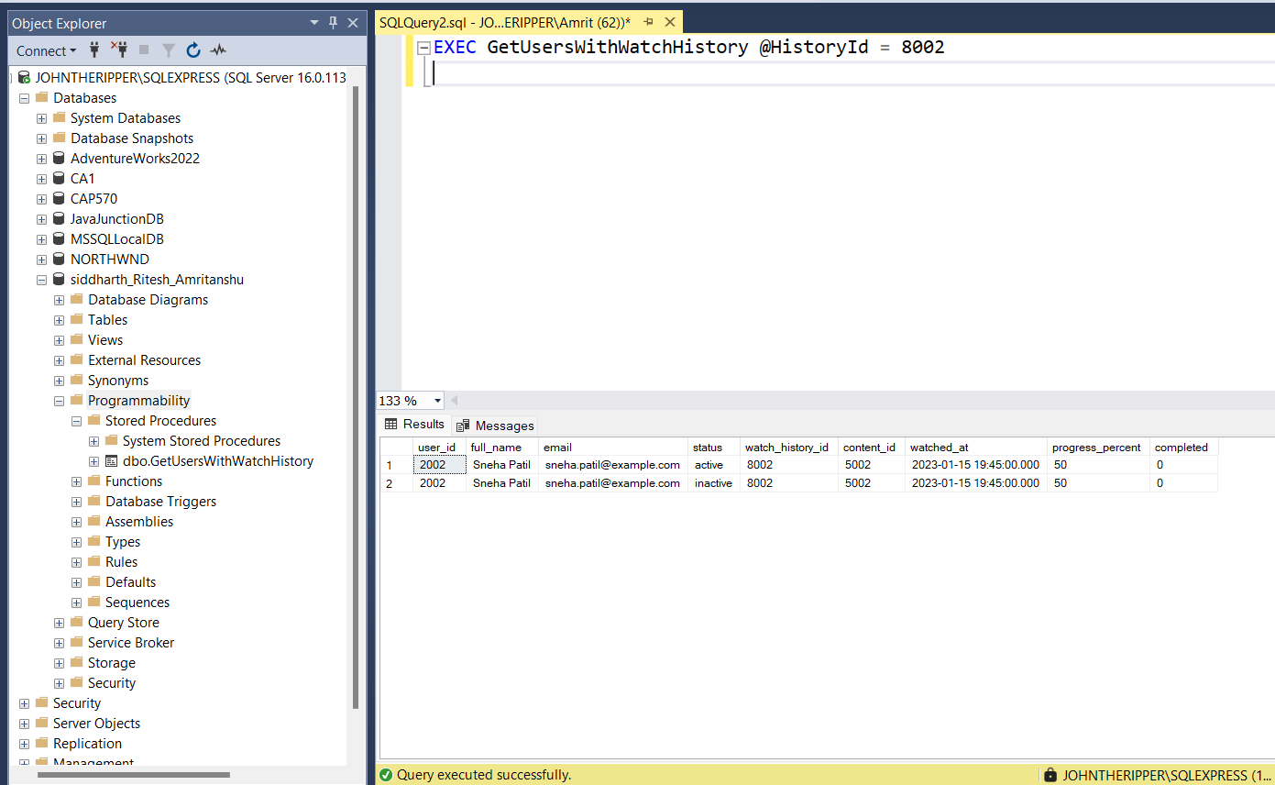
Stored procedure fetches user details and watch history for a specified HistoryId, with error handling to manage exceptions during execution.
CREATE PROCEDURE GetUsersWithWatchHistory
@HistoryId INT
AS
BEGIN
BEGIN TRY
SELECT DISTINCT
U.user_id, CONCAT(U.first_name, ' ', U.last_name) AS full_name,
U.email, S.status, WH.history_id AS watch_history_id,
WH.content_id, WH.watched_at, WH.progress_percent, WH.completed
FROM users U
INNER JOIN subscriptions S ON U.user_id = S.user_id
INNER JOIN watch_history WH ON U.user_id = WH.user_id
WHERE WH.history_id = @HistoryId;
PRINT 'Query executed successfully.';
END TRY
BEGIN CATCH
DECLARE @ErrorMessage NVARCHAR(4000) = ERROR_MESSAGE();
DECLARE @ErrorSeverity INT = ERROR_SEVERITY();
DECLARE @ErrorState INT = ERROR_STATE();
PRINT @ErrorMessage;
RAISERROR (@ErrorMessage, @ErrorSeverity, @ErrorState);
END CATCH
END;
EXEC GetUsersWithWatchHistory @HistoryId = 8002

Slide 19
A cursor in T-SQL is a database object that utilizes a temporary memory/workstation during DML operations to retrieve, manipulate, and process rows from a result set one at a time, allowing row-by-row operations when updates or sequential processing of database tables are required.
The cursor lifecycle in T-SQL includes declaring with DECLARE, opening with OPEN, fetching rows with FETCH NEXT, and finally closing with CLOSE and deallocating with DEALLOCATE to release resources.
CURSOR

Slide 20
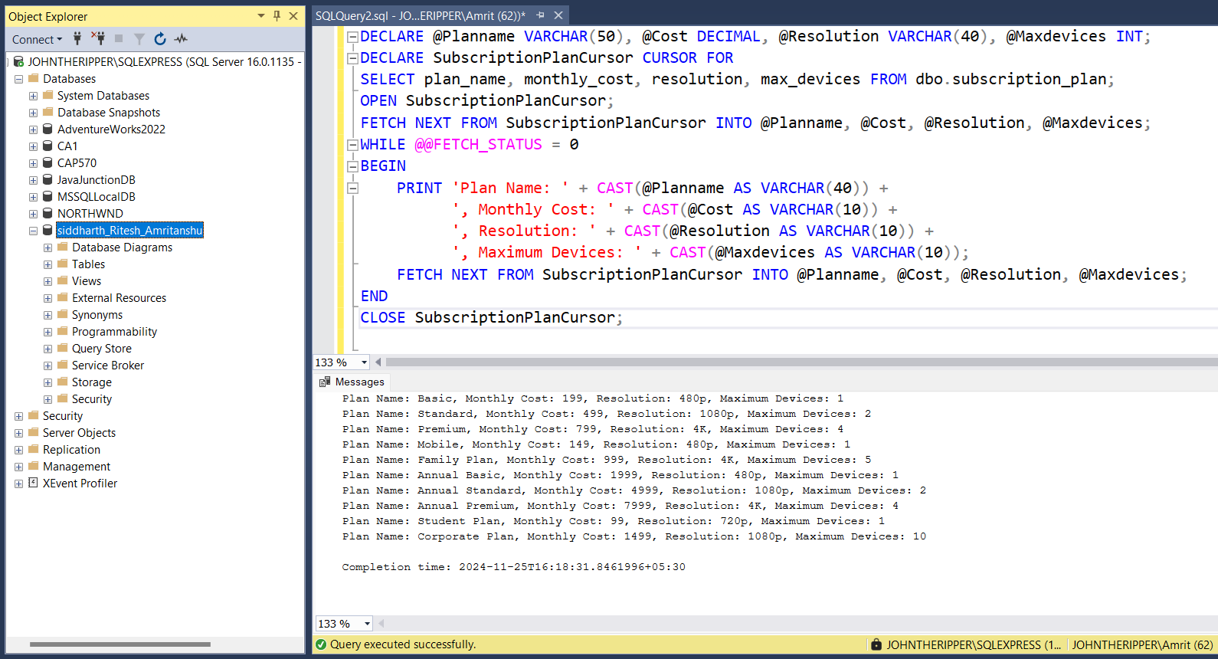
Cursor to iterate through subscription plans and display details like plan name, monthly cost, resolution, and maximum devices for each row
DECLARE @Planname VARCHAR(50), @Cost DECIMAL, @Resolution VARCHAR(40), @Maxdevices INT;
DECLARE SubscriptionPlanCursor CURSOR FOR
SELECT plan_name, monthly_cost, resolution, max_devices FROM dbo.subscription_plan;
OPEN SubscriptionPlanCursor;
FETCH NEXT FROM SubscriptionPlanCursor INTO @Planname, @Cost, @Resolution, @Maxdevices;
WHILE @@FETCH_STATUS = 0
BEGIN
PRINT 'Plan Name: ' + CAST(@Planname AS VARCHAR(40)) +
', Monthly Cost: ' + CAST(@Cost AS VARCHAR(10)) +
', Resolution: ' + CAST(@Resolution AS VARCHAR(10)) +
', Maximum Devices: ' + CAST(@Maxdevices AS VARCHAR(10));
FETCH NEXT FROM SubscriptionPlanCursor INTO @Planname, @Cost, @Resolution, @Maxdevices;
END
CLOSE SubscriptionPlanCursor;
DEALLOCATE SubscriptionPlanCursor;

Slide 21
CONCLUSION

Slide 22

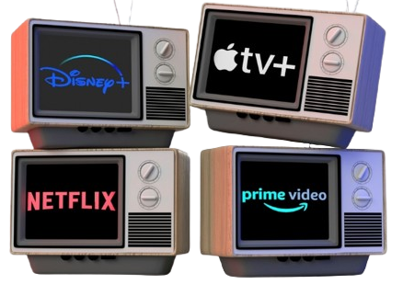

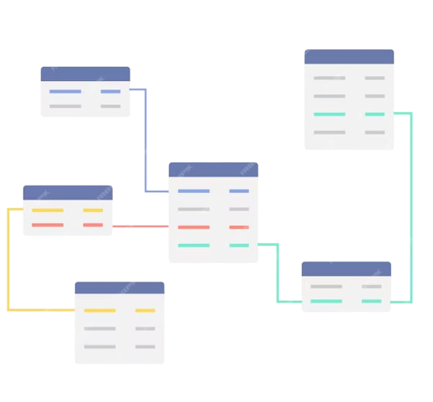
01
02
03
04

Slide 23


